Slide 1
Data Lake Overview

Slide 2
The Need for Data Lake
Before the Data Lake
Defining Data Lake
Key benefits of Data Lake
Challenges in implementing a Data Lake
When to go for a Data Lake implementation
Architecture
Data Lake And Future Trends

Slide 3
Before the Data Lake
What were my total sales in the last year?
What was the sales performance of x unit in y geography in z timeframe?

Slide 4
Question??
How did R.Ashwin perform in last Test match?(High Level problem statement)
Why?
R.Ashwin performed well ( 6/41 ) in yesterday’s match!
Complex historical data can quantify how well he has performed Can we say why did he do well in this particular match?
What factors affected his enhanced performance?

Slide 5
FACT is a FACT …
even when we don’t know how it can be used

Slide 6
What is a data lake?
Data lake is a huge repository that holds every kind of data in it raw format until it is needed by anyone in the organization to analyze.
Data Lake is not Hadoop. It uses different tools.
Data Lake is not a database in the traditional sense of word. A typical implementation of data lake uses various NoSQL and InMemory Data bases that could co-exist with its relational counterparts.

Slide 7
Key benefits of Data Lake
Scale as much as you can.
Plug in disparate data source.
Acquire high velocity data.
Store in native format.

Slide 8
Challenges in implementing a Data Lake
A Data Lake is a complex solution as there are many layers involved in building it and each layer utilizes a lot of Big Data tools and technologies to accomplish it's functionality.
Another important aspect is data governance; as the data lake is aimed at bringing in all of the organization's data together, it should be built with enough governance so that it does not turn into a group of unrelated data silos.

Slide 9
When to go for a Data Lake implementation
Your organization is planning to extract insights from huge volumes or a high velocity of data a traditional data warehouse is incapable of handling.
Your organization needs to build data products that use new data taht is not yet prepared and structured.
There is a need for near real-time analytics for faster/better decisions and point-of-service use.

Slide 10
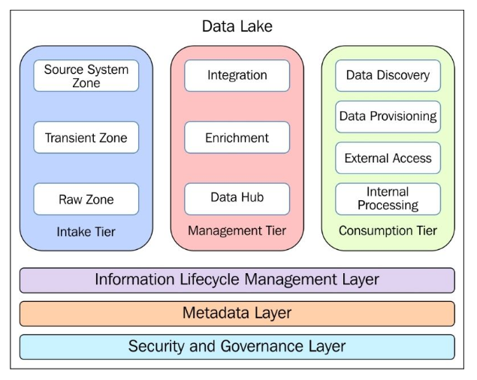
Architecture

Slide 11
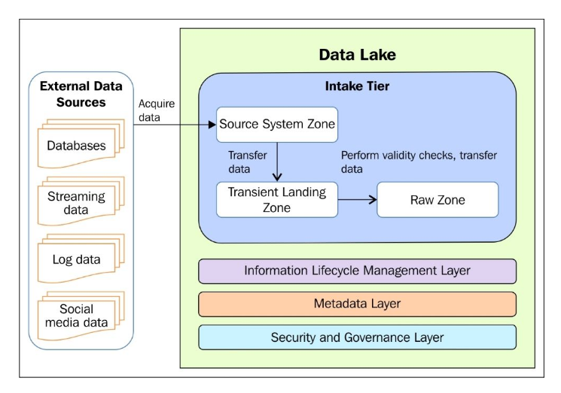
Intake Tier

Slide 12
Management Tier
The Key purpose of the Management Tier is to acquire data from the Raw Zone of the Intake Tier and package it so that the data is ready for exploration, discovery and provisioning and consumption by the end users or applications.

Slide 13
Consumption Tier
How this data can be discovered, packed and provisioned for it to be consumed by the downstream system.

Slide 14
Data Lake And Future Trends
The demand for extreme high speed insights.(Lamda Architure)
The growth of IOT
The evolution of deep learning

